Slide 1
A collection of Greek Ritual Norms (CGRN)
Vinciane Pirenne, Jan-Mathieu Carbon, Saskia Peels
Université de Liège
cgrn@ulg.ac.be

Slide 2




A Collection of Greek Ritual Norms (CGRN)
2011-2015
Saskia Peels
Vinciane Pirenne-Delforge
Jan-Mathieu Carbon
+ collaborators

Slide 3
A Collection of Greek Ritual Norms (CGRN)
2011-2015
Online collection of 250 inscriptions which are conventionally referred to as ‘sacred laws’.
Date range: 7th-1st cent. B.C.
All parts of the Greek world.
Thematic focus on sacrifice and purification.
* For all individual files:
Description, edition, translations in English and French, bibliography, commentary.
* Extensively browseable and searchable database.

Slide 4
An example of a ‘sacred law’ (a.k.a. ritual norm)
Ἀθηναίηι Πατρ-
οίηι ⋮ ἔρδεται τὤ-
τερων ἔτως τέλ-
η ⋮ καὶ γυνακες (sic) ⋮ λα-
5 [γ]χάνωσιν
‘To Athena Patroea
A sacrifice of perfect animals is performed
every other year.
Women also obtain
a cut of the meat’.

Slide 5
Functionalities of the website
BROWSE
SEARCH
All 250 files one by one
By date
By location
By Greek word
By type of text
By theme
Search of English/French content
Search of Greek content: String of Greek characters
or lemmatized search
Search for specific themes: e.g. types of animals, festivals
Results may be filtered (by time, place, type of text)
Advanced searches combining search criteria possible

Slide 6
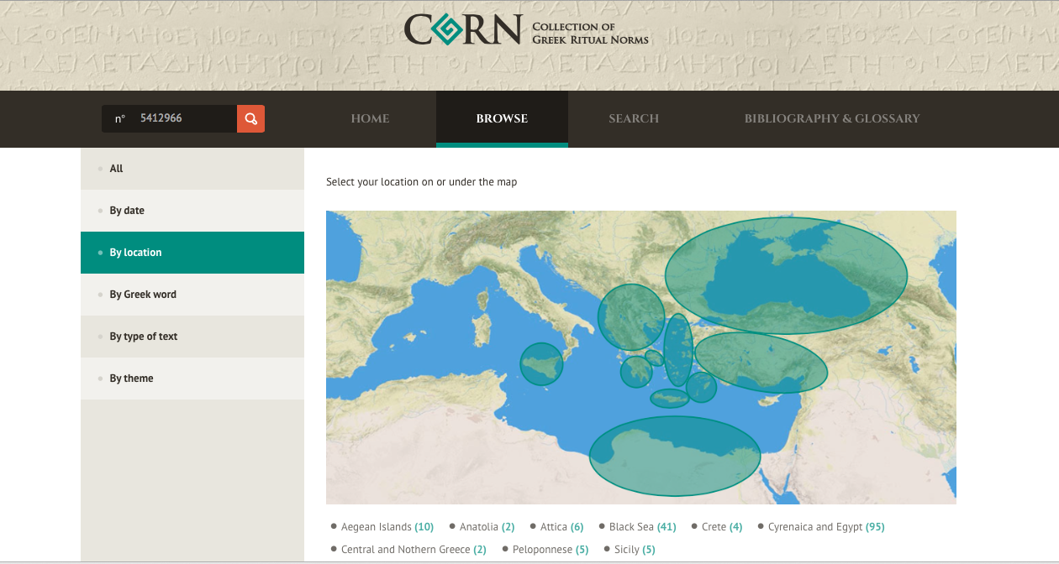
An example ...

Slide 7

The website will be available during the conference ...
Thank you for your interest!

